Slide 1
Hiding in plain sight - unannotated structural variants in public genomic data sets
Premise:
Public data, such as gnomAD, makes VCFs of short nucleotide variants (SNVs) available. There is anecdotal evidence that some apparent “insertions” are actually part of larger structural variants
Questions:
Can we use VCFs of SNVs to call structural variants? In doing so, can we identify SVs that have otherwise escaped detection?

Slide 2
Example deletion in gnomAD
Deletion
Aligns downstream from the source position
Exactly flanks a known deletion in dGV (database for genomic variants)
BLAST Best Hit
If alignment is downstream relative to "inserted" sequence and on + strand, keep as deletion.

Slide 3
Example tandem dup in gnomAD
Tandem dup
inserted sequence aligns to originating position, indicating 2 copies of sequence at the same site
Overlaps known duplication in dGV
BLAST Best Hit
If alignment starts at originating position or upstream and is on + strand, keep as tdup

Slide 4
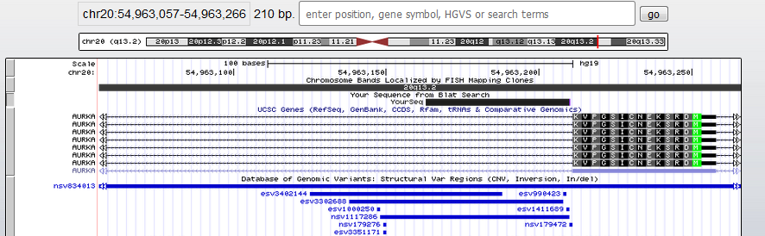
Example tandem dup in gnomAD

Slide 5
Example of inversion in gnomAD
Sorry, I don't have a gnomAD example handy.
Expect the "inserted" sequence to align on the minus strand either upstream or downstream
Will be more prone to false positives. Consider only calling those that overlap known inversions in dGV.
BLAST Best Hit
If alignment is on – strand (either up/downstream) keep as potential inversion

Slide 6
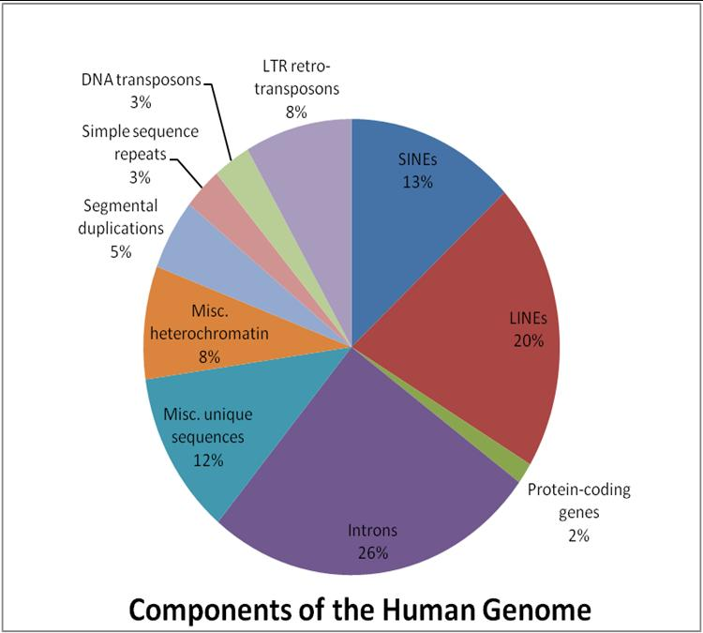
You are half MEI
MEIs are repetitive sequence that "copy & paste" themselves into new locations in the genome
A surprising finding from the first draft of the human reference genome was the abundance of MEI sequence
There are nearly 4 million MEIs and MEI sequence fragments in the human genome.
Only a small fraction are “active” and capable of creating new insertions (~100 L1s and a few hundred Alus).
https://commons.wikimedia.org/wiki/File:Components_of_the_Human_Genome.jpg

Slide 7
Active Mobile Elements in Humans
L1 – 6kb
Protein-coding
~500k copies
SVA – 2kb
Long RNA
~3k copies
Alu – 300 bp
Intermediate RNA
~1.1M copies
https://etd.library.emory.edu/concern/etds/1c18dg327?locale=en

Slide 8
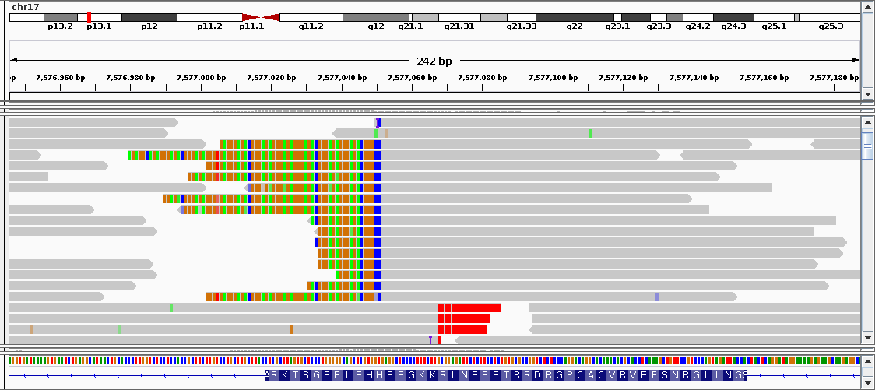
MEIs

Slide 9
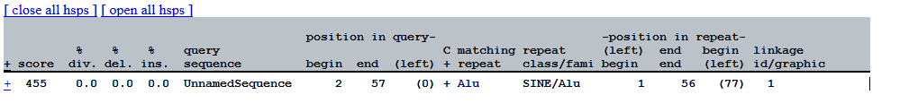
Example of MEI in gnomAD
http://gnomad.broadinstitute.org/variant/7-129066575-C-CGGCCGGGCGCGGTGGCTCACGCCTGTAATCCCAGCACTTTGGGAGGCCGAGGCGGG
BLAT won't work because MEIs are repetitive sequence and are masked.
BLAST will align to thousands of sites in the genome.
Can either align the "inserted" sequence by RepeatMasker or do pairwise alignment to known MEI consensus sequences

Slide 10
Processed Pseudogenes (pgenes)
Exon-only copies of genes that may be polymorphic or missing from reference genome.
Original Gene Locus
Processed Pseudogene Locus
reverse transcription and re-integration elsewhere in the genome
transcription and splicing into mRNA
a given gene can have multiple pgene progeny
pgenes can be fixed, polymorphic, or rare
the reference genome is known to be missing common pgenes (e.g., PMID: 24026178)

Slide 11
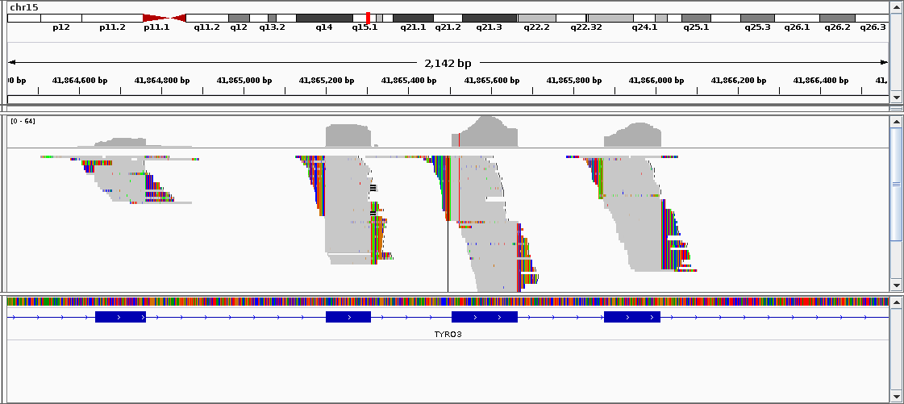
TYR03 processed pseudogene
Excess of "insertion" sequence at exon boundaries
Important to identify pgenes to:
determine whether variants are really where you think they are
determine whether we are missing variant calls due to dilution of alternate allele reads
prevent over-calling of intronic "deletions"

Slide 12
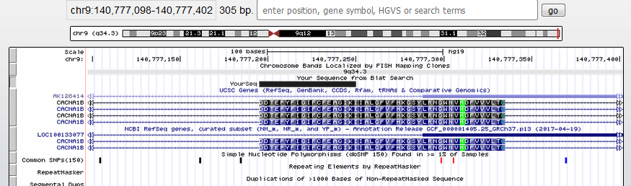
Example of processed pseudogene in gnomAD
CACNA1B gene
http://gnomad.broadinstitute.org/variant/9-140773612-G-GACGACACGGAGCCCTATTTCATCGGGATCTTTTGCTTCGAGGCAGGGATCAAAA
Appears to be "inserted" sequence at chr9:140773612
This is actually an exon boundary
The inserted sequence aligns to the next exon

Slide 13
VCF Parser
BLAST
Make SV Calls
Post-Processing
Web Interface
Grab insertion alt alleles
convert to fastaA
Grab starting position
Align against MEI library
Align against originating chromosome
use tab delim BLAST output
subset for good alignments
use logic to define SVs
merge overlapping calls
call pgenes
overlap with known events
further SV call refining
make raw and merged calls available
be able to subset by SV type and region
IN: VCF
IN: FASTA
IN: BLAST OUTPUT
OUT: FASTA
OUT: BLAST OUTPUT
OUT: BED
IN: ANNOTATED BED
IN: BED
OUT: UI, DOWNLOADS
OUT: ANNOTATED BED

Slide 14
VCF Parser
For each chromosome:
Find indels with insertion length > 25
Some insertions have “anchor bases” for a REF (e.g., AATTCCA > AATTCCAT)
Subtract length of REF from length of ALT to determine length of insertion
Grab the alt sequence
Write to fastA with header of sequence being the originating position and something to unique it (e.g., >chr21:1234567_1)

Slide 15
BLAST
BLAST against the originating chromosome reference sequence
BLAST against an MEI library
First, need to build BLAST dictionary with makeblastdb command
blastn -task megablast -query $fasta -db $db \
-best_hit_score_edge 0.1 -gapopen 5 -gapextend 2 \
-reward 1 -penalty -1 -word_size 11 -out $out \
-outfmt "6 qseqid sseqid qcovs stitle qlen slen qstart qend sstart send qseq sseq evalue bitscore score length pident nident mismatch positive gapopen gaps ppos sstrand"

Slide 16
Make SV Calls - Prepare
Choose “good” alignments
Recommend: bitscore > 50, fraction of query aligned > 90%, gaps < 3, percent identity > 90%
If an original sequence aligned multiple times, choose the “best”
Recommend: highest bitscore, nearest to originating site

Slide 17
Make SV Calls - Deletions
Sequence should align downstream and on the plus strand
Recommend: use a size filter (50 bp < deletion < 1e5 bp)

Slide 18
Make SV Calls - Inversions
Sequence can align either upstream or downstream from the originating site
Alignment should be on the minus strand relative to subject (chromosome reference)
Recommend: use a size filter ( 1kb < inversion < 1e5 bp)

Slide 19
Make SV Calls – Tandem Dups
Sequence should align upstream (or exactly at originating site) and on the plus strand
Recommend: use a size filter (50 bp < deletion < 1e5 bp)

Slide 20
Post-Processing
Merge similar calls within each SV type
call processed pseudogenes from deletions
overlap with known structural variants (and other functional annotation)
Determine overlap of SV breakpoints with simple repeats (these would be low confidence calls)

Slide 21
Post-Processing – Merge similar calls within each SV type
Recommend using bedtools to determine which calls have >90% reciprocal overlap with each other.
Hint: bedtools merge does not have reciprocal overlap, but bedtools intersect does
When merging, use the smallest start coordinate, the largest end coordinate, and average the bitscores

Slide 22
Post-Processing – Merge similar calls within each SV type (MEIs)
For MEIs, merge within each MEI family (Alu, L1, SVA) and within each orientation (plus, minus)
Combine calls that are the same family, same orientation and within some number of bp from each other
Recommend: 20 bp window
When combine, average the starts, ends, and bitscores

Slide 23
Post-Processing – call processed pseudogenes from deletions
A “deletion” precisely overlapping an intron is most often evidence of a processed pseudogene
Use a bed file of introns to see which deletions have >90% reciprocal overlap with an intron

Slide 24
Post-Processing – overlap with known structural variants
gnomAD has an SV call set (they didn’t when I submitted the hackathon proposal, but they do now)
Determine which of our SV calls overlap gnomAD SV calls
Within a given SV type (e.g., compare our deletions to gnomAD deletions)
Recommend: 50% reciprocal overlap
Little script in util to pre-process gnomAD bed file into separate SV types
Can also determine overlap with 1000 Genomes SVs

Slide 25
Post-Processing – overlap the start site with simple sequence
Okay, this is not the most sophisticated SV caller
It will be “tricked” by simple, repetitive sequence
Let’s add a flag for whether the originating site overlaps with known simple sequence
Can download simple sequence bed file from UCSC Genome Browser
Create a bed of just the starts of our SVs

Slide 26
Shiny App
Allow users to retrieve results based on some filtering:
Genomic region - chr:start-stop or gene symbol
SV type - deletion, inversion, tandem dup, processed pseudogene, or MEI
Whether previously known in gnomAD/1KG
Whether breakpoints overlap simple repeats
Minimum bitscore
Provide a table output and option to download results
Provide some visualization in genome context?

